Slide 1
Simplex Control and Message/ACK Exchange - Module 6 Final Presentation
Renato Iida: rfiida@wpi.edu
Le Wang: lewang@wpi.edu
Rebecca Cooper: rrcooper@wpi.edu

Slide 2
Outline
Purpose
Proposed Diagram
Implementation
Interfacing
Recorded Demonstration
Lesson Learned

Slide 3
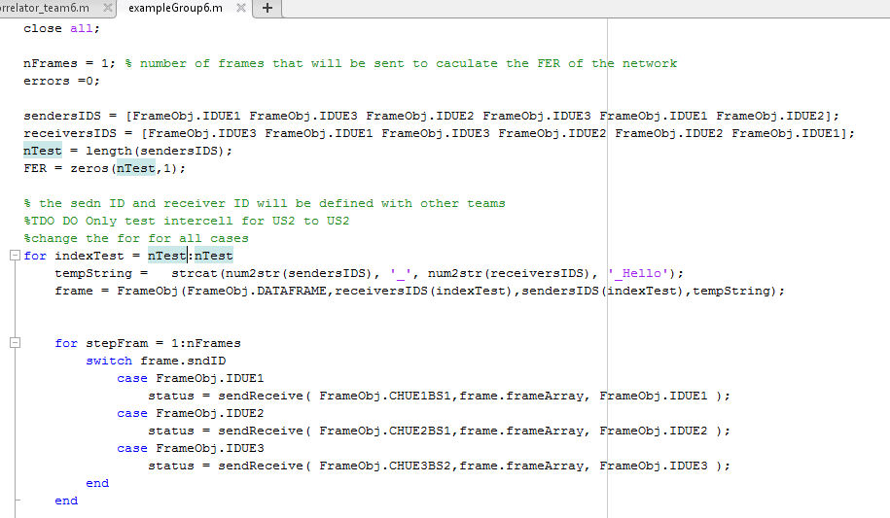
End-to-end communication
Test Array
Generate Package
End-to-End
Communication

Slide 4
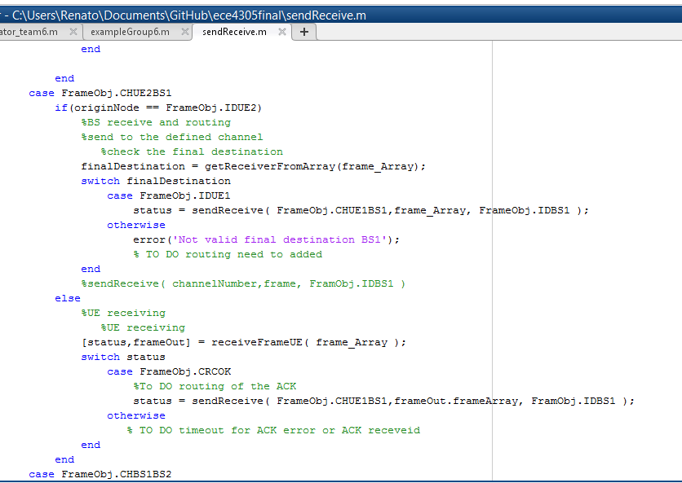
Send and Receive Method
BS2
UE2

Slide 5
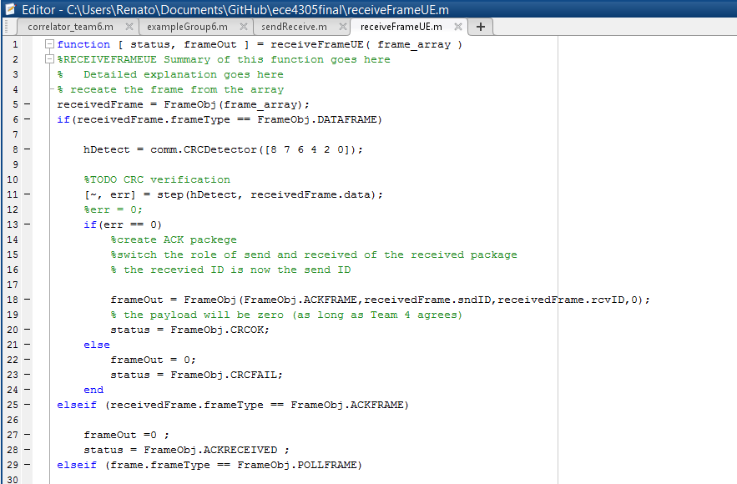
UE Receive Process
CRC
Verification
ACK Packet Creation
Receiving ACK

Slide 6
Routing from the Base Stations
The physical layer will received the frame and pass it to us.
We will read the receiver ID.
Use address table from team 5 to determine which physical resource will send the frame.
Team 3 will determine if it needs to be stored.

Slide 7
Code
The Team 4 add the new Frame Types
The Team 4 and 6 code are merged
Using the same repository.

Slide 8
Next Week
Call the transmission and receiver methods from Team 1,2,3.
Verify with Team 5 how to get the address tables to update routing.
Fine tune the timeout of the end-to-end based on specification of the network

